Slide 1
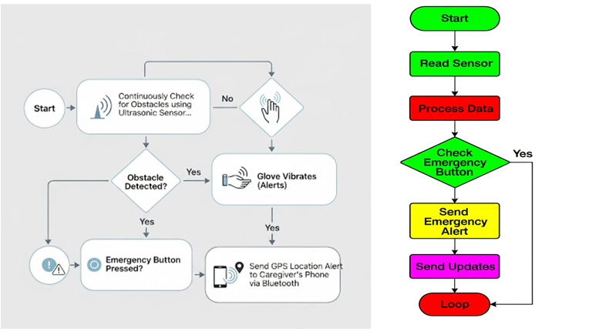
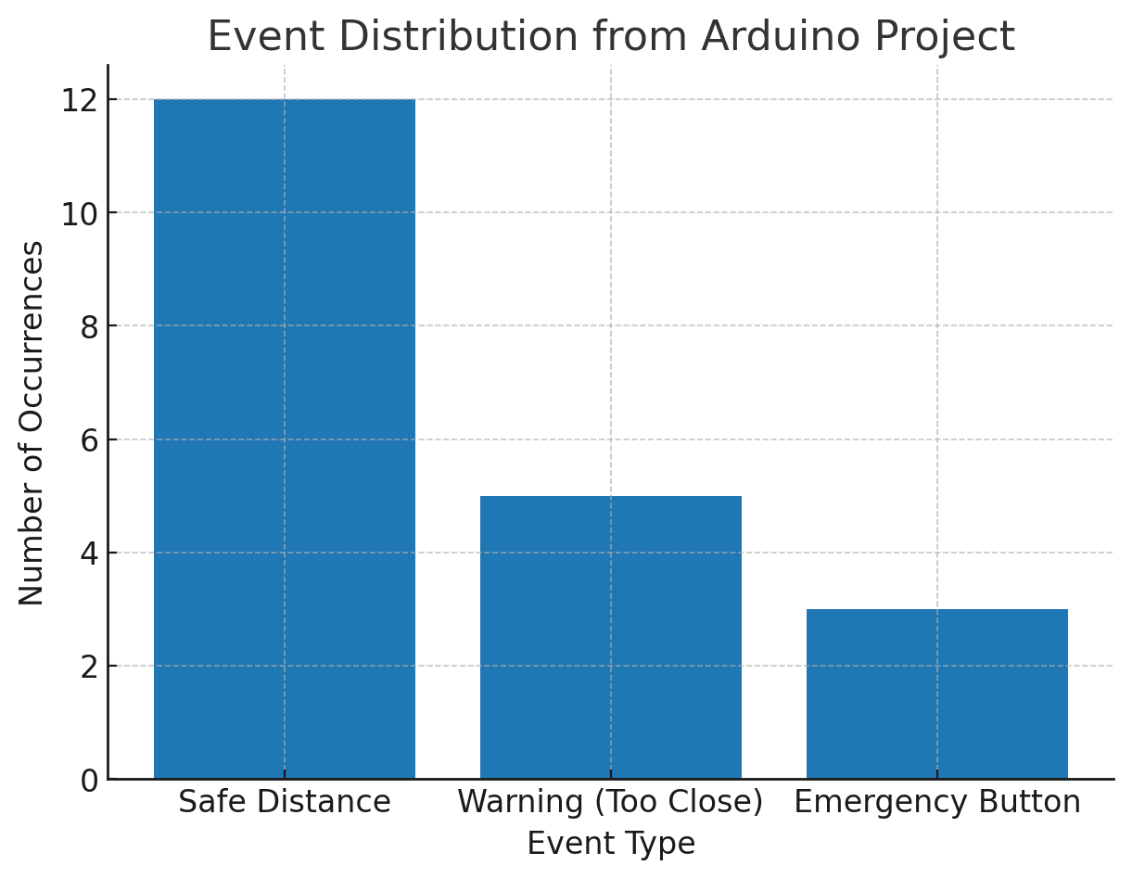
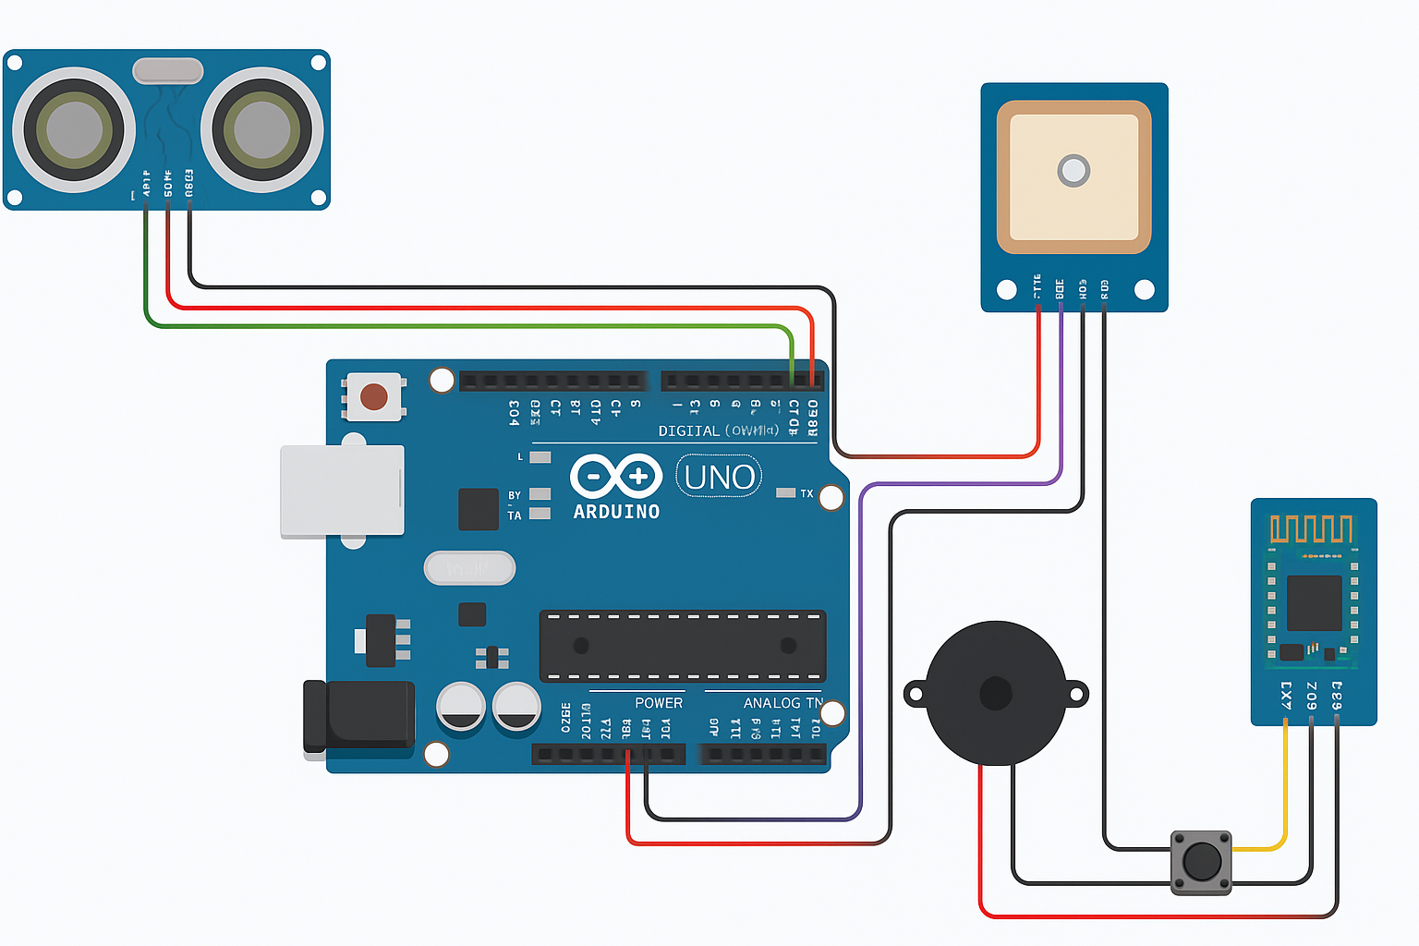
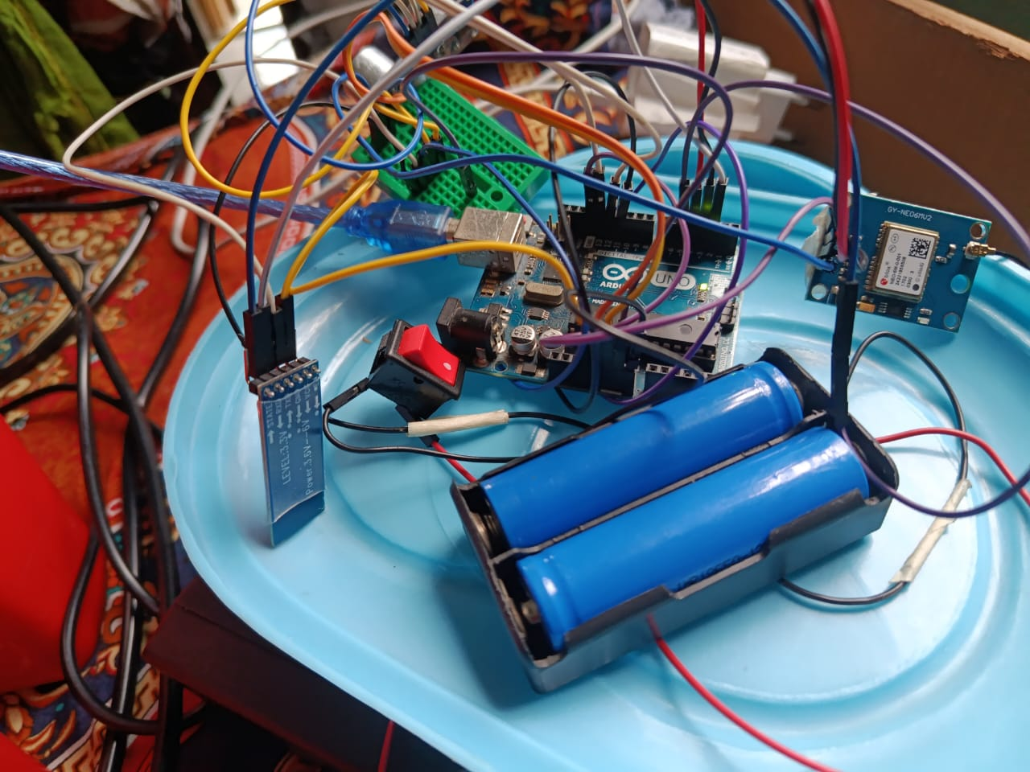
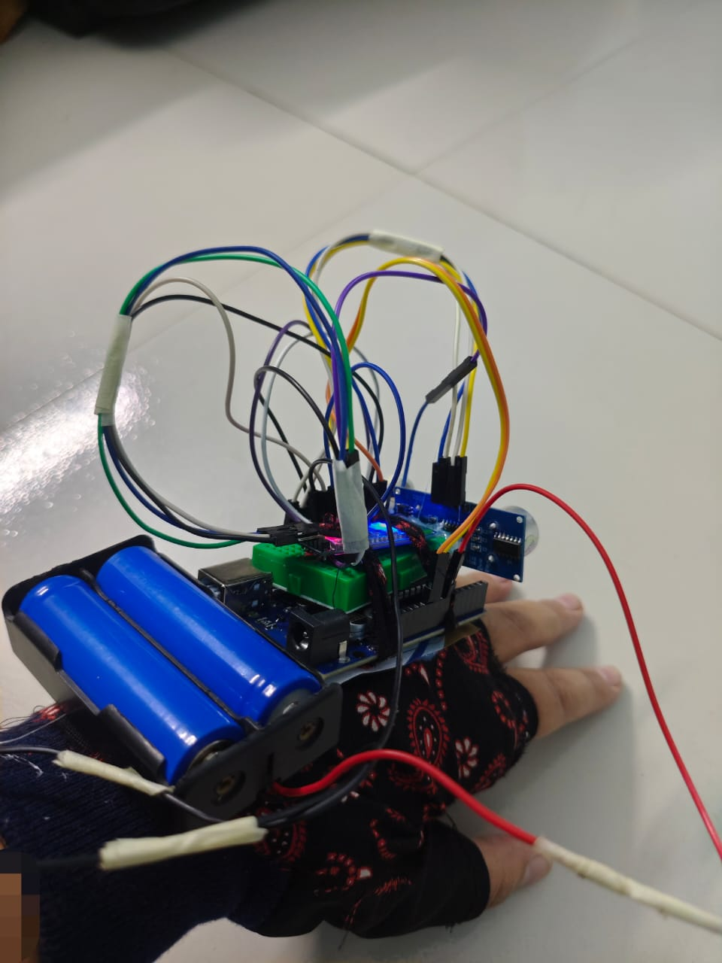
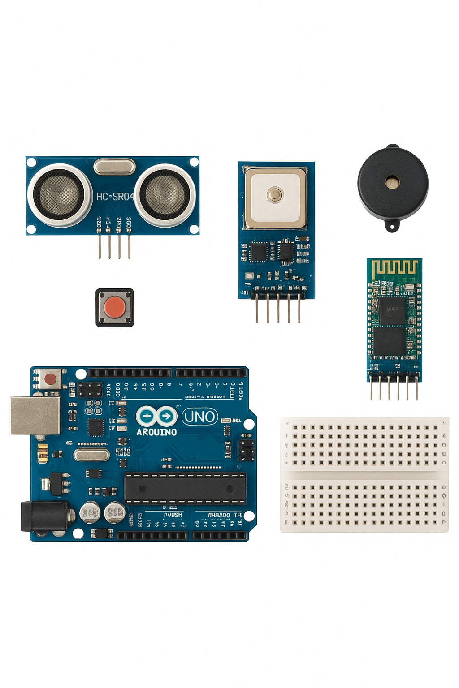
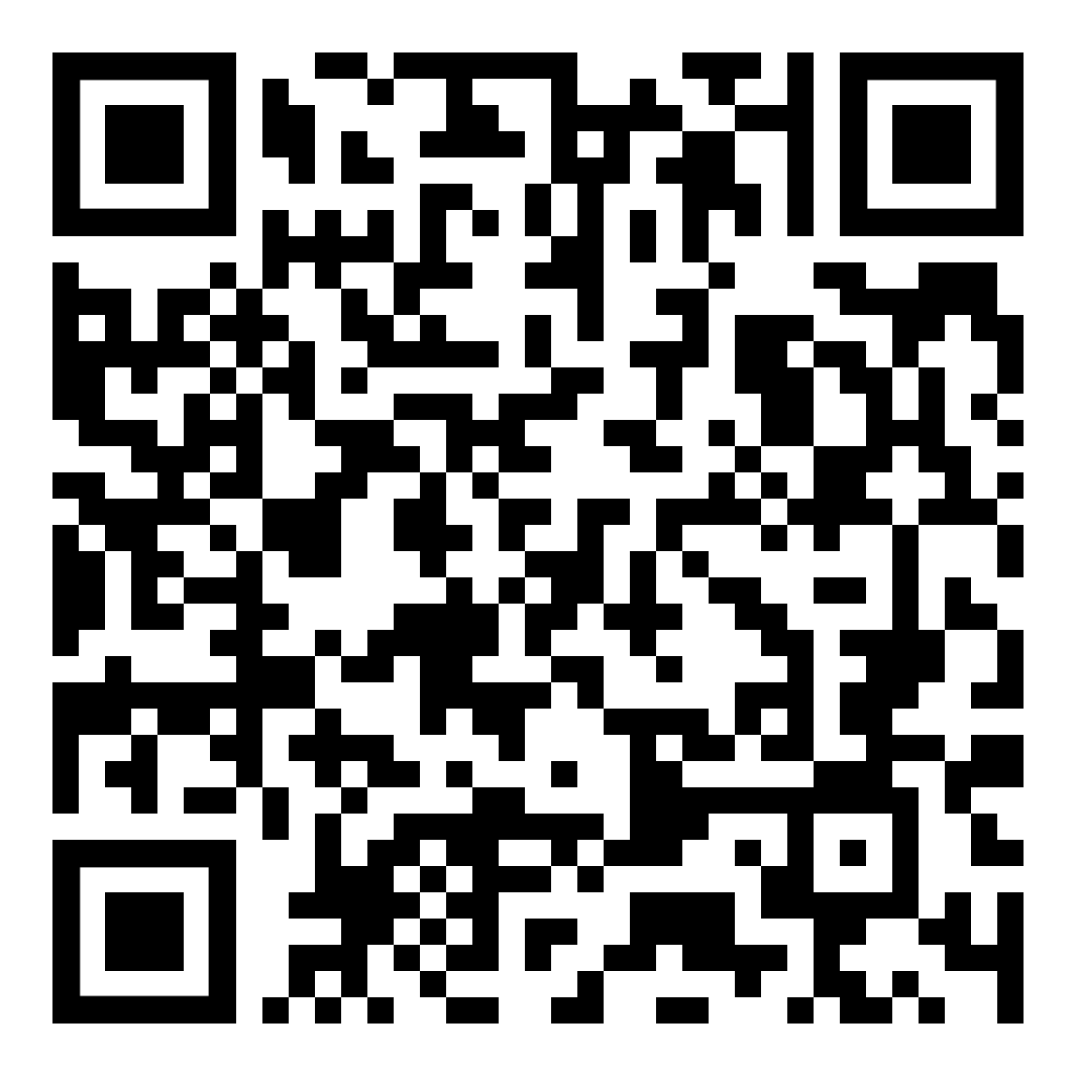
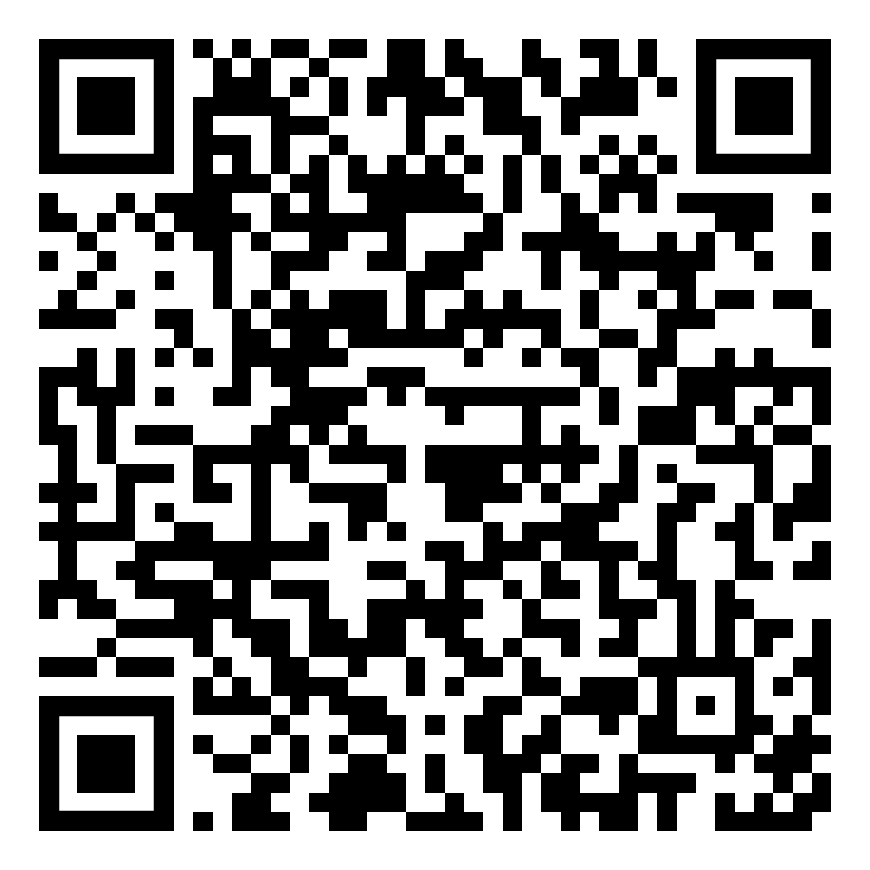
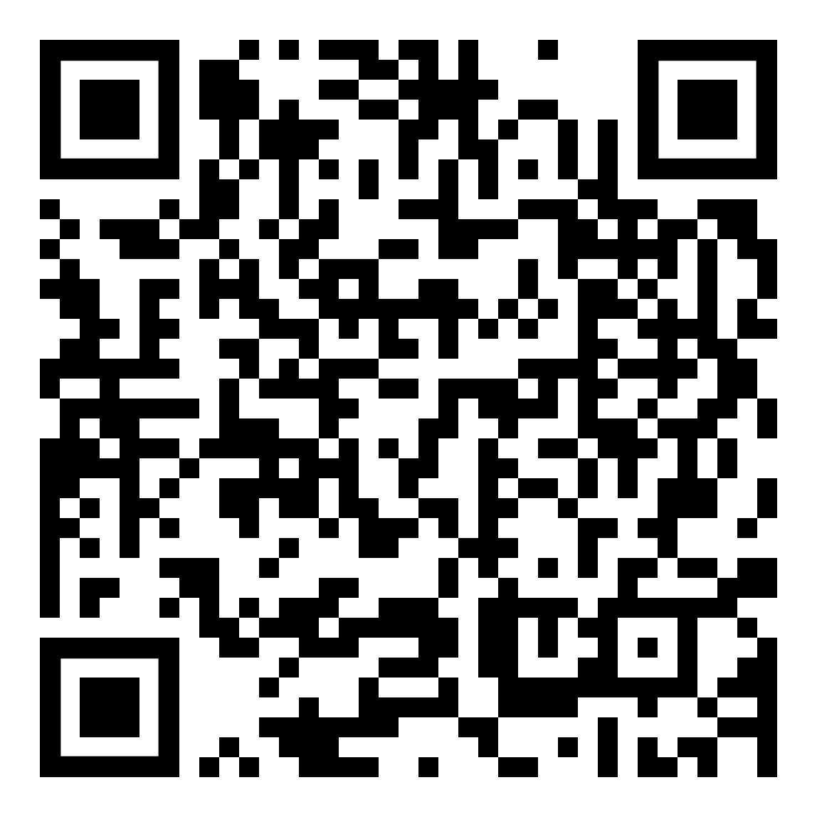
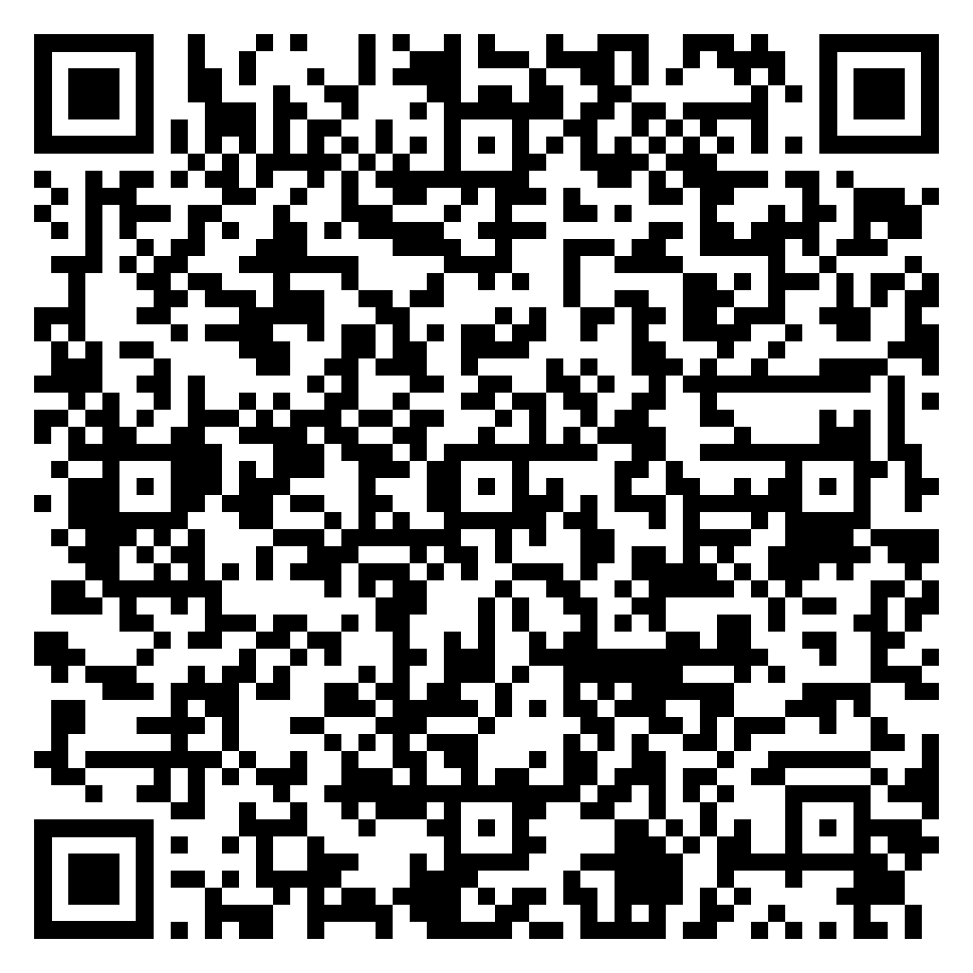
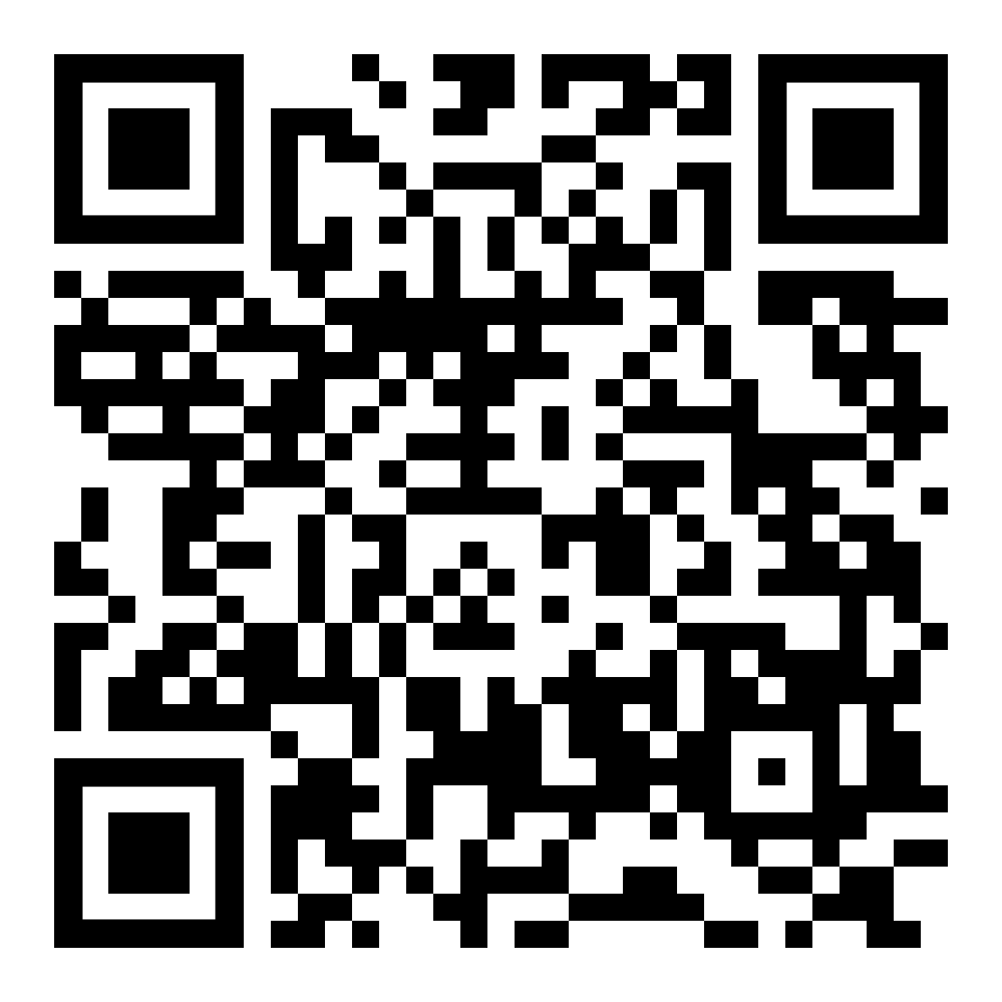
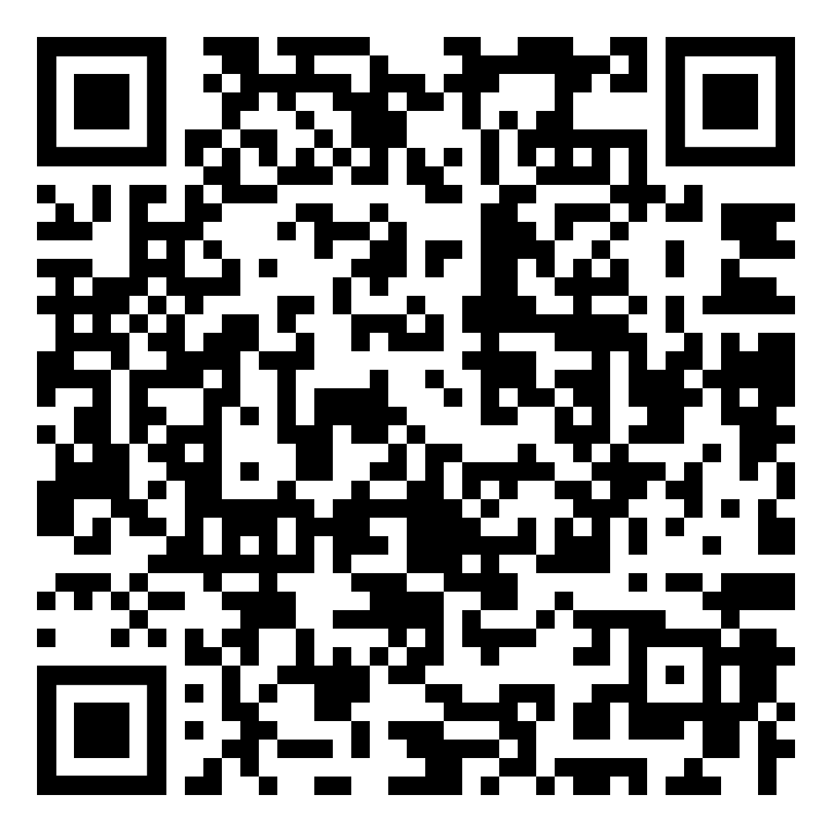
HandNav: Smart Gloves for Blind People
Joya Rani Saha(2201008)
, Rawnak Mahzabin Jyoti(2201010)
, Takia Yasmin(2201049)
Department of Internet of Things and Robotics Engineering, Gazipur Digital University, Bangladesh
Supervised by-Sadia Enam,Lecturer,Dept of IRE,GDU
Introduction
Methodology
Results
System Block Diagram
The Smart Glove is a wearable device designed to improve mobility, safety, and independence for visually impaired users. It uses ultrasonic sensors to detect obstacles in real-time and provides buzzer and vibration feedback for immediate awareness. A GPS module allows accurate location tracking, while Bluetooth enables seamless communication with connected devices. An emergency button lets users send instant distress alerts. offering a compact, reliable, and user-friendly navigation aid.
Problem Definition and Contribution
Fig.4: HandNav control flow
Goal: The goal of the Smart Glove project is to enhance the mobility, safety, and independence of visually impaired individuals by providing a compact, wearable device that offers real-time obstacle detection, navigation assistance, and emergency support.
Contribution:
Integrates ultrasonic sensors for real-time obstacle detection.Includes GPS module for accurate location tracking.Uses Bluetooth for seamless communication with devices.Offers LED and vibration alerts for immediate awareness of obstacles.Features an emergency button for instant distress signals. Empowers users to navigate confidently and efficiently in daily life.
Conclusions
The smart glove integrates ultrasonic sensing, GPS, Bluetooth, and emergency alerts into a wearable device. It detects obstacles, alerts users with a buzzer, and shares real-time data like location and speed. In emergencies, it quickly sends distress messages with GPS coordinates, enhancing safety for visually impaired individuals. With improvements such as voice output and better GPS accuracy, it can become a practical and affordable assistive tool.
Fig.1: Workflow of Smart Glove System
Fig.3: Bar chart of system events – Safe, Warning, Emergency.
The bar chart illustrates the event distribution recorded in this project.
The x-axis represents the types of events (Safe Distance, Warning, Emergency), while the y-axis represents the number of occurrences for each event.
The Safe Distance event occurred 12 times, meaning the ultrasonic sensor detected no immediate obstacles within the critical range.
The Warning (Too Close) event occurred 5 times, indicating that an object was detected within 10 cm of the sensor, triggering a safety alert.
The Emergency Button event was triggered 3 times, showing that the user manually pressed the emergency button to send a danger alert.
This visualization helps to understand system performance by showing how frequently each type of event occurs. From the data, it is clear that the system mostly operated in a Safe Distance state, with fewer instances of warnings and emergencies.
Future Work
Voice Output Integration
Enhanced GPS Accuracy
Mobile App Support
Low Power Design
AI-based Obstacle Detection
Requirements
Hardware:
Arduino Uno
HC-SR04 Ultrasonic Sensor
GPS Module
Bluetooth Module
Buzzer
Push Button
Resistors & Connecting Wires
Breadboard / Power Supply (5V/USB battery pack)
Software:
Arduino IDE
TinyGPS++library SoftwareSerial library
Serial Monitor
Bluetooth App
References
Fig.2: Hardware diagram

